Slide 1
AI PROJECT

Slide 2
Chandramouli Bavana Sukkrishvar Vijay Santhana Krishnan

Slide 3
RESUME PARSER AI

Slide 4
Objectives:
This project aims to automate the initial screening process in recruitment by analyzing resumes and categorizing candidates based on their qualifications and experience.
.1. Developed an AI-driven platform capable of accurately parsing resumes across multiple formats, including Word, PDF, and plain text.
2. Skillfully extracts pertinent details from standard resumes, including personal information, educational background, skills, and certifications.
3. Classify resumes into job categories using machine learning algorithms.

Slide 5
GitHub Portfolio
https://github.com/sukkrishvar-vijay/Resume-Parser

Slide 6
Output

Slide 7
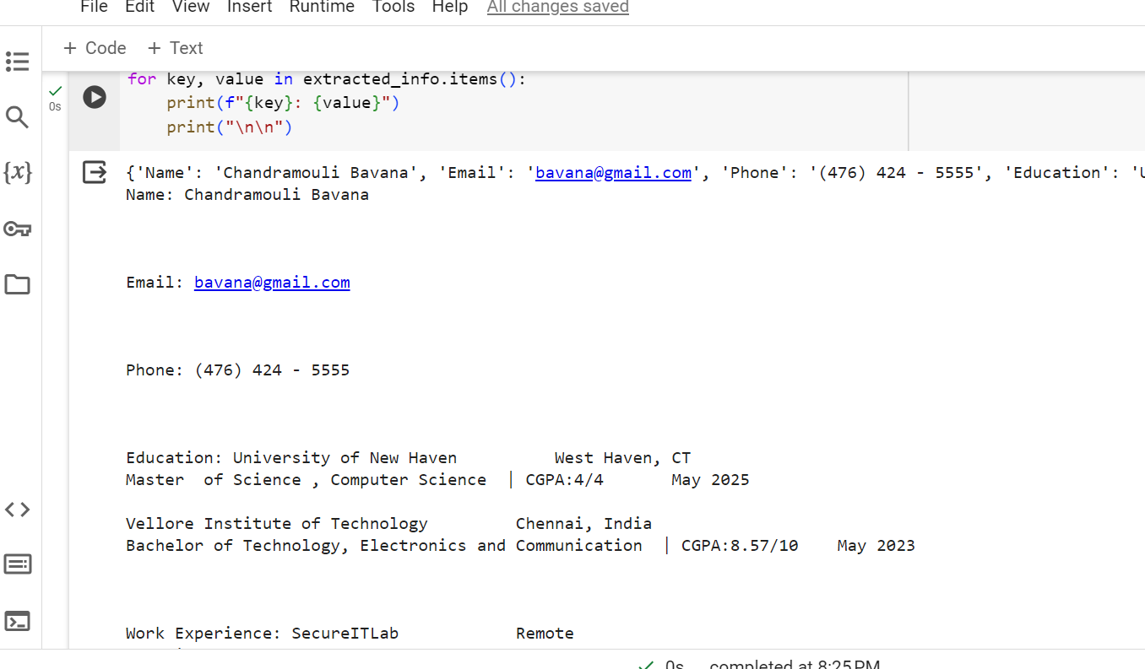

Slide 8
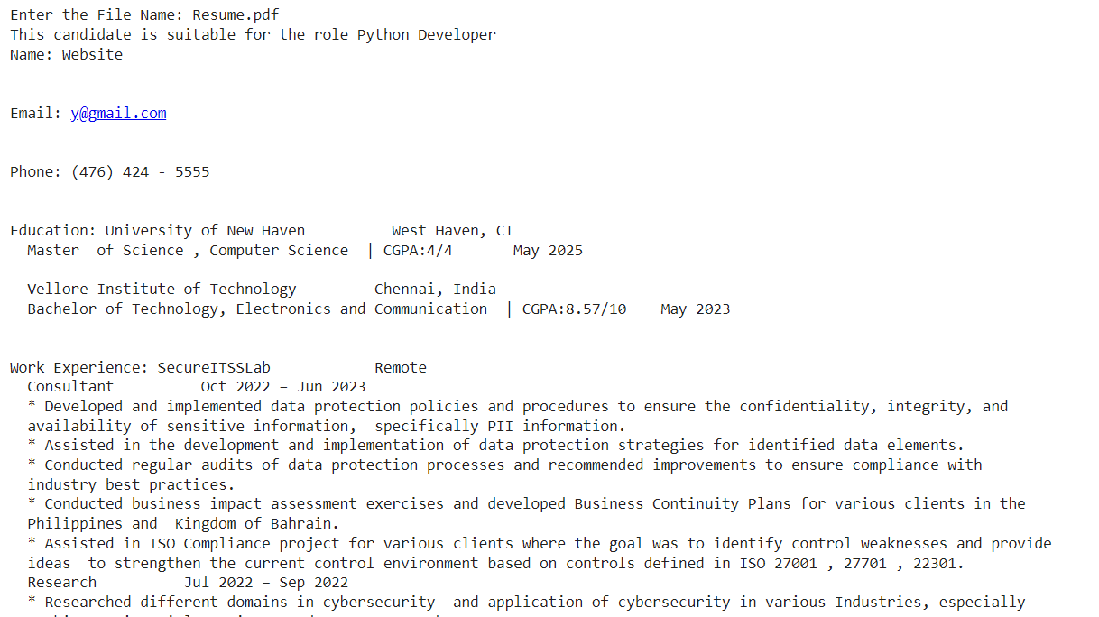

Slide 9
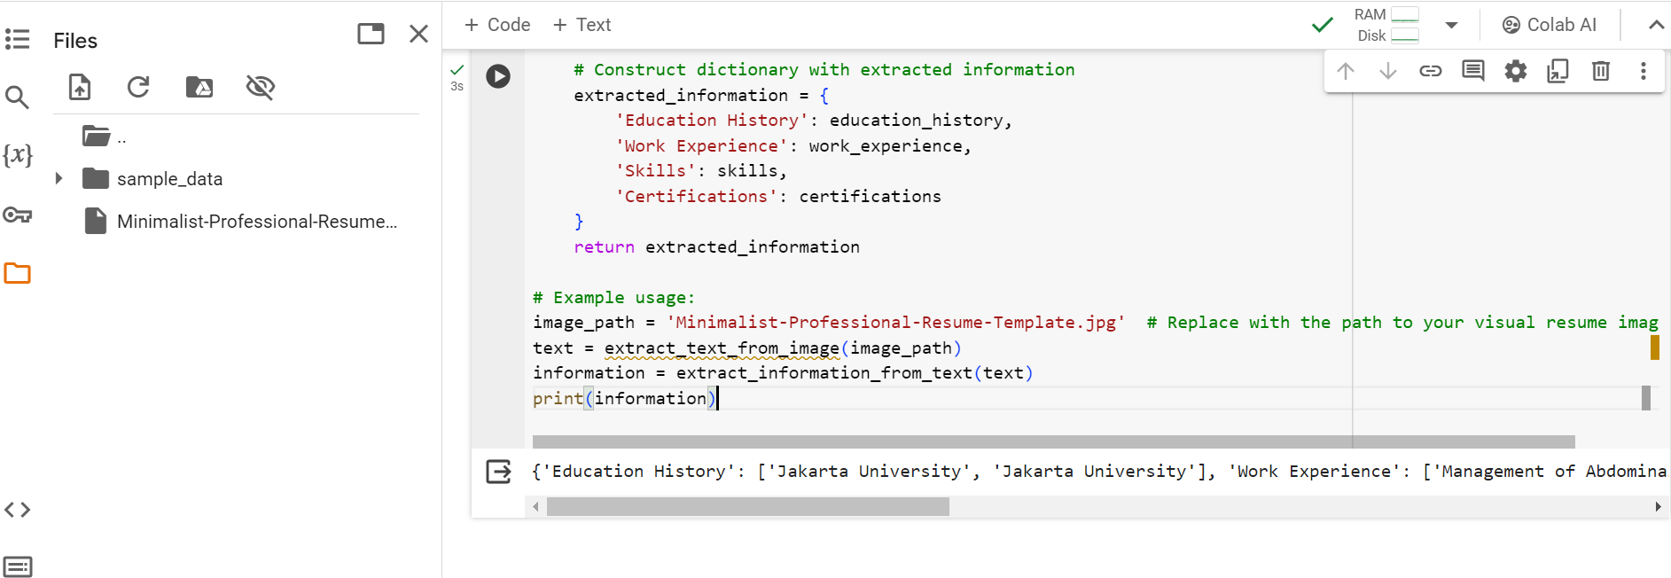
Output2

Slide 10
References
https://www.kaggle.com/datasets/gauravduttakiit/resume-dataset
https://blog.apilayer.com/build-your-own-resume-parser-using-python-and-nlp/

